Slide 1

CRYPTO WALLET
TEAM MEMBERS:
2010030087 PAVAN VKHYATH
2010030364 YASHWANTH
2010030512 KEERTHANA

Slide 2
TABLE OF CONTENTS
ABSTRACT
INTRODUCTION
LITERATURE SURVEY
FLOW CHART
IMPLEMENTATION
SCOPE
SOFTWARE & HARDWARE REQUIREMENTS
GITHUB COMMITS
WORK FLOW
CONCLUSION

Slide 3
ABSTRACT
Cryptocurrency wallets are software applications on computers or mobile devices such as phones or tablets. They use an internet connection to access the blockchain network for the cryptocurrency you're using.
Wallets contain a public key (the wallet address) and your private keys needed to sign cryptocurrency transactions.
Cryptocurrencies are not "stored" anywhere—they are bits of data stored in a database. These bits of data are scattered all over the database; the wallet finds all of the bits associated with your public address and sums up the amount for you in the app's interface.

Slide 4
A cryptocurrency wallet is an application that functions as a wallet for your cryptocurrency. It is called a wallet because it is used similarly to a wallet you put cash and cards in. Instead of holding these physical items, it stores the passkeys you use to sign for your cryptocurrency transactions and provides the interface that lets you access your crypto.
Modern cryptocurrency wallets make the blockchain accessible to everyone. When cryptocurrency was first introduced, sending cryptocurrency was a manual task that required entering long keys. Today, the software does most of it for you.
Blockchain is a public ledger that stores data in what's known as "blocks." These are records of all transactions, the balances held at any given address, and who holds the key to those balances. Crypto isn't stored "in" a wallet, per se. The coins exist on a blockchain and the wallet software allows you to interact with the balances held on that blockchain. The wallet itself stores addresses and allows their owners to move coins elsewhere while also letting others see the balance held at any given address.
INTRODUCTION

Slide 5
LITERATURE SURVEY
s.n0 | author | year | title | outcome
1 | Ju-Chun Ko | June 2019 | Crypto Wallet Working on Low-cost 4G LTE Mobile Phone (video) | In this paper, we describe a simple and light way of using 4G LTE low-cost phone as blockchain cryptocurrencies wallet on-the-go. The main purpose of this project is to make general mobile phone user could easily use Crypto Wallet " a crypto currency wallet connected to the blockchain without installing an App, to get benefit from decentralized financial services such as e-commerce, Peer to Peer financial services etc. In this research, we have implemented a full-functional e-commerce Web App through WordPress combining with WooCommerce open-source package, with additional Crypto Wallet plugin compose by PHP installed, which allows user to create crypto wallet and make transaction on a very low-cost phone such like Nokia 8810 4GLTE, worth only $80. With the possibility of using low-cost phone to do Blockchain and cryptocurrency related operations, it may lead us to a more distributed commerce, and equally traded world.
2 | Tatyana A. Lomazina; Tatyana G. Surovtsova; Dmitrii A. Ivanov | Published in: 2021 International Conference on Quality Management, Transport and Information Security, Information Technologies (IT&QM&IS) | Development of a Cryptocurrency IoT wallet with Automatic Authentication | The paper studies a practical implementation of Internet of Things device personalization. The solution of this problem greatly contributes to the creation of a system of devices that exchange trusted data. A fundamental architecture for a new information system that implements crypto wallets with automatic authentication of IoT devices, is proposed. The architecture provides a secure method of wallet initiation on a device. Internet of Things poses significant restrictions on hardware and software. The main problems are ensuring communication between IoT devices, optimizing the energy consumption of devices and small processing power. Changes in existing libraries and program code were required to implement the IoT wallet. The presence of a wallet makes it possible for the device to buy or sell data for crypto coins, for example, temperature readings of a video feed. This will contribute to the emergence of a new economic model in which the data collected is sold, not the devices themselves. Where seller IoT device transfers impersonal data to the customer and other IoT device validates integrity of data that is transferred. Based on integrous of data and its relevance other IoT device rates the seller and data costs.

Slide 6
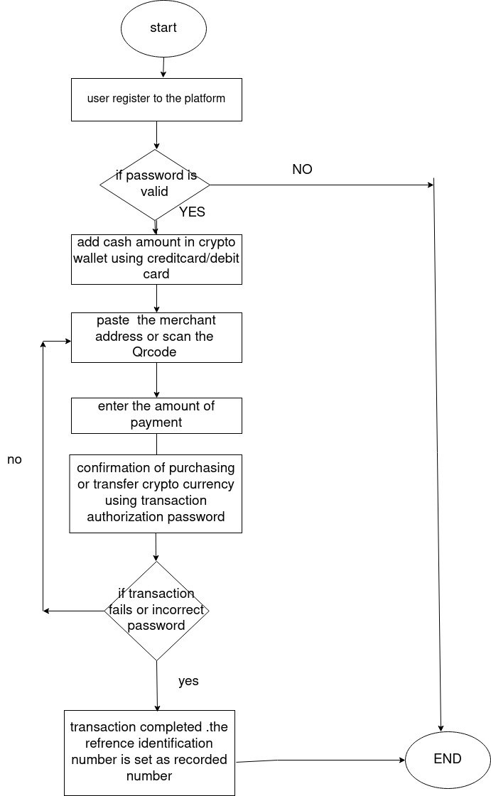
FLOW CHART

Slide 7
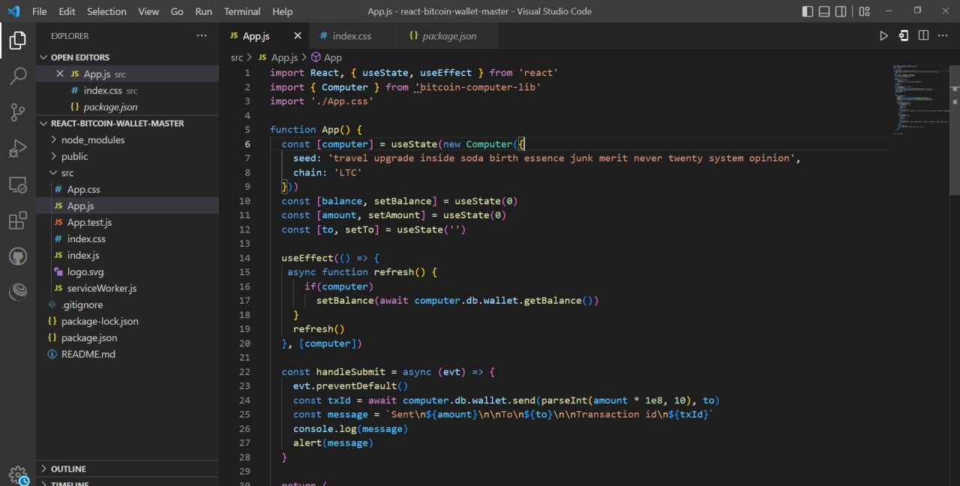
IMPLEMENTATION

Slide 8
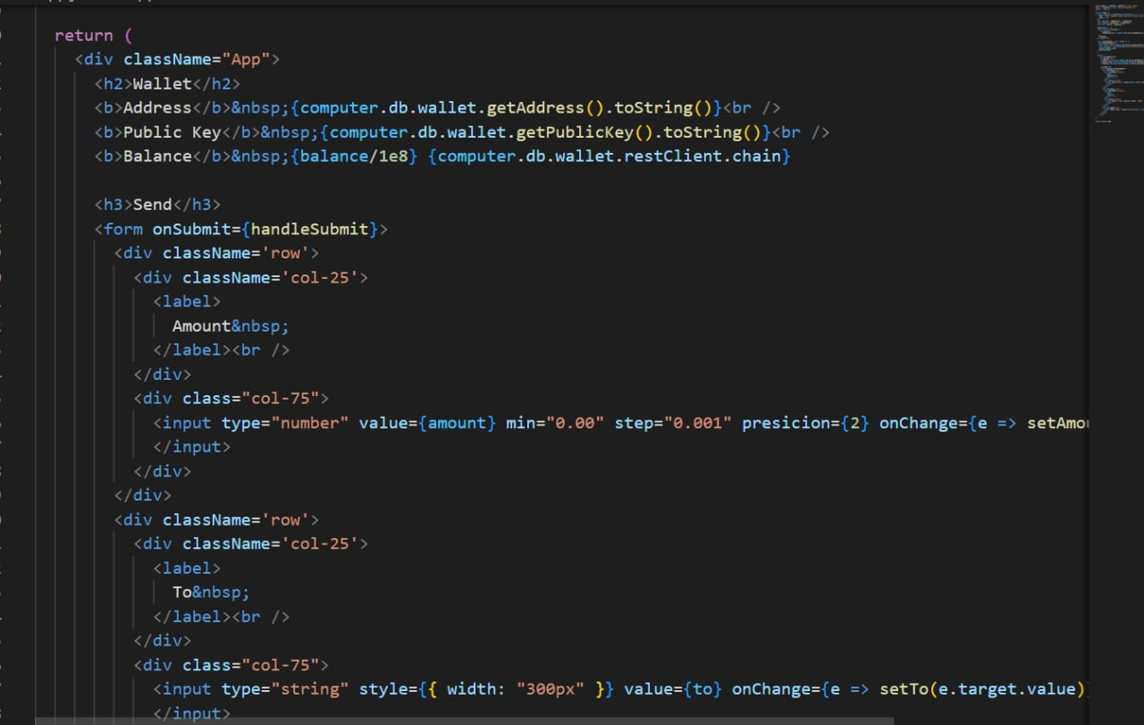
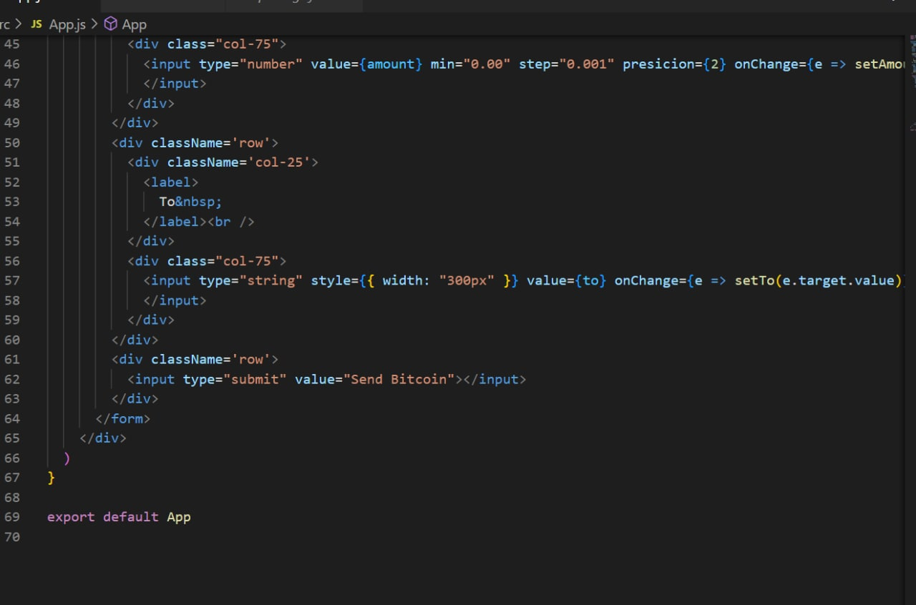

Slide 9
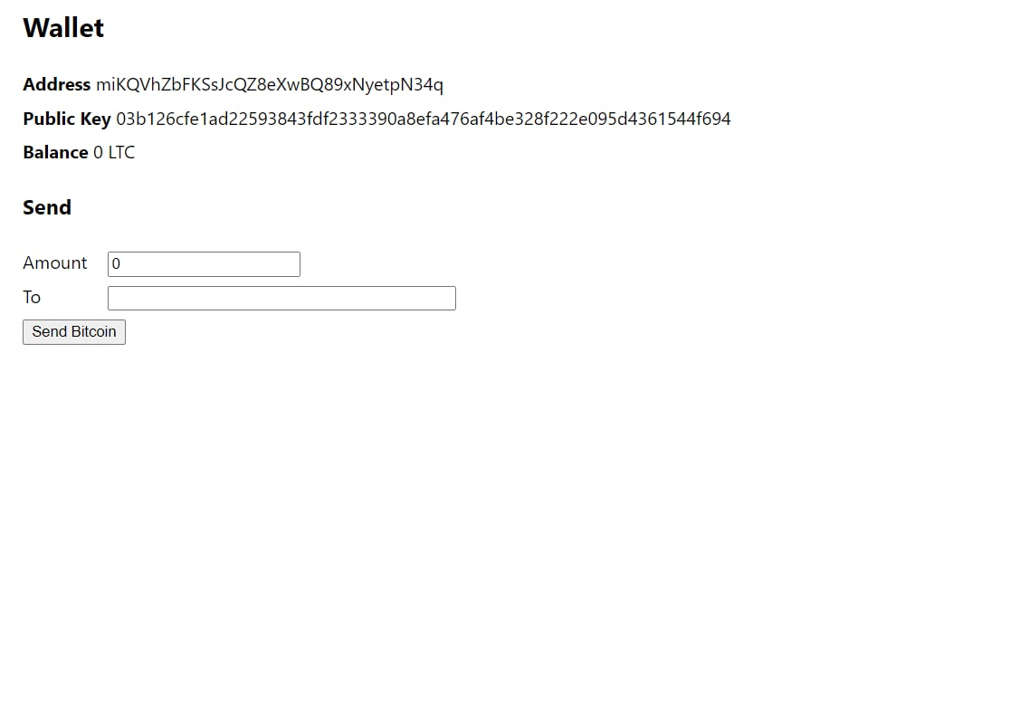
OUTPUT

Slide 10
SOFTWARE & HARDWARE REQUIREMENTS
HARDWARE REQUIREMENTS:
System : Pentium Dual Core.
Hard Disk : 2.80 GB.
Monitor : 15’’ LED
Input Devices : Keyboard, Mouse
Ram : 4 GB
SOFTWARE REQUIREMENTS.
Operating system : Minimum Windows 7.
Coding Language : JAVA, Solidity.
IDE : Eclipse, Mata Mask Wallet , VS code.

Slide 11
Easy to use. It's just like any other software or a wallet that you use for your day-to-day transactions.
Highly secure.
Allows instant transactions across geographies.
Low transaction fees.
Allows transactions across multiple cryptocurrencies.
SCOPE

Slide 12
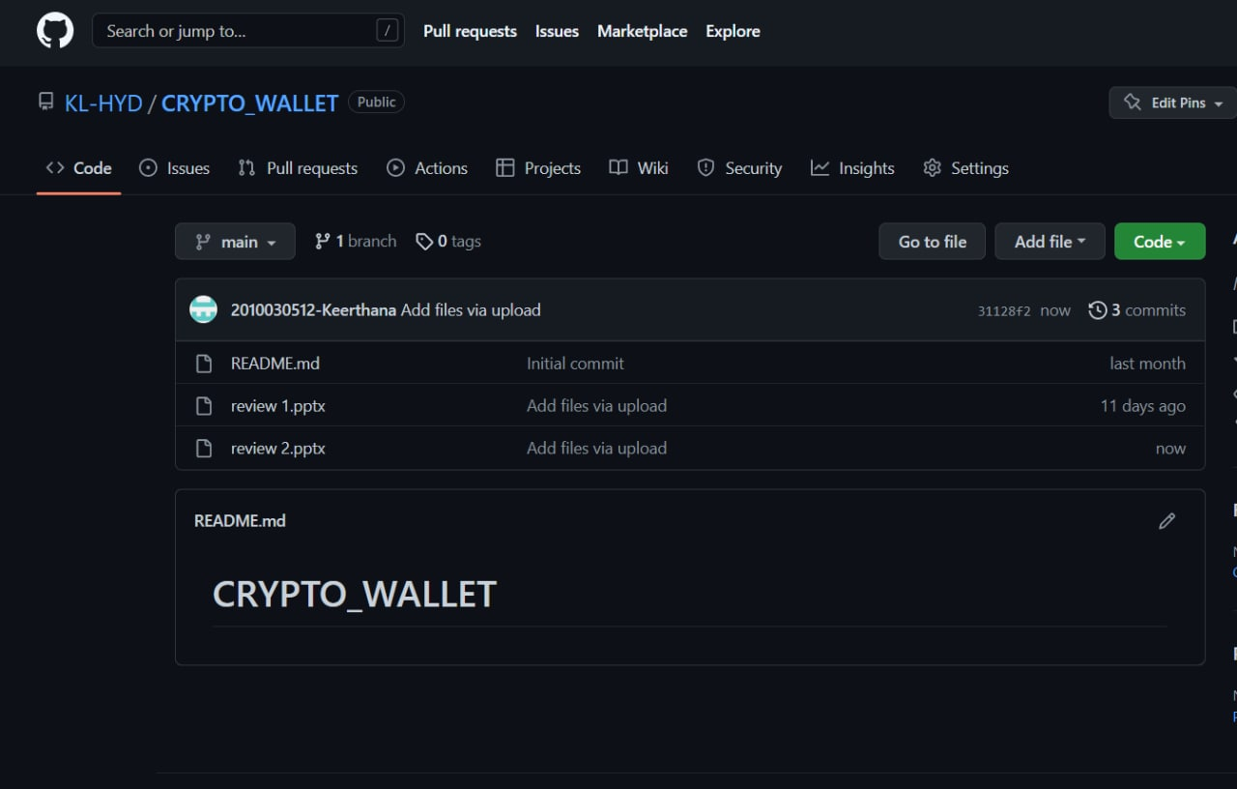
GITHUB COMMITS

Slide 13
connected to metamask
created transaction page
WORK FLOW

Slide 14
CONCLUSION
The adoption of technology depends on the requirements of the business here in the case is for the banking system.
The no of profits margin derives the adoption of technology. Most of the Banks around the globe have adopted blockchain
As they value customer's privacy in the first place. There are always pros and cons related to each technology which goes
The same in the case of blockchain too. They only problem with technology is the cost. The cost drives the business day
To day operations, so this is where the banks have to think carefully before the adoption of this technology.
The blockchain-based banking system becomes more temper proof when it is powered by blockchain.

